Slide 1
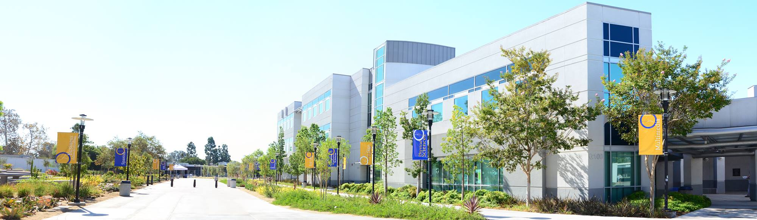
Revisiting Our
Institution-Set Standards:
Part II
Bri Hays
Campus-Based Researcher
Presented to the Planning and Institutional Effectiveness Committee
October 24, 2015

Slide 2
What are Institution-Set Standards?
Institutionally-developed standards of performance
Allows for comparison of actual performance to standards in a number of areas
  Success rate
  Retention (fall-to-fall persistence) rate
  Students who received degrees
  Students who received certificates
  Students who received an award (certificate or degree)
  Transfers
  CTE program licensure exam pass rates
  CTE program employment/job placement rates

Slide 3
Why Now?
USDE requires accrediting commissions to evaluate of the appropriateness of student achievement measures selected by colleges
ACCJC addressed this requirement in the 2013 annual report
In 2013 we referred to our previously-established process of using 5-year averages as our “institution-set standards”
We now have the opportunity to review our standards and revise as needed
Continuous quality improvement

Slide 4
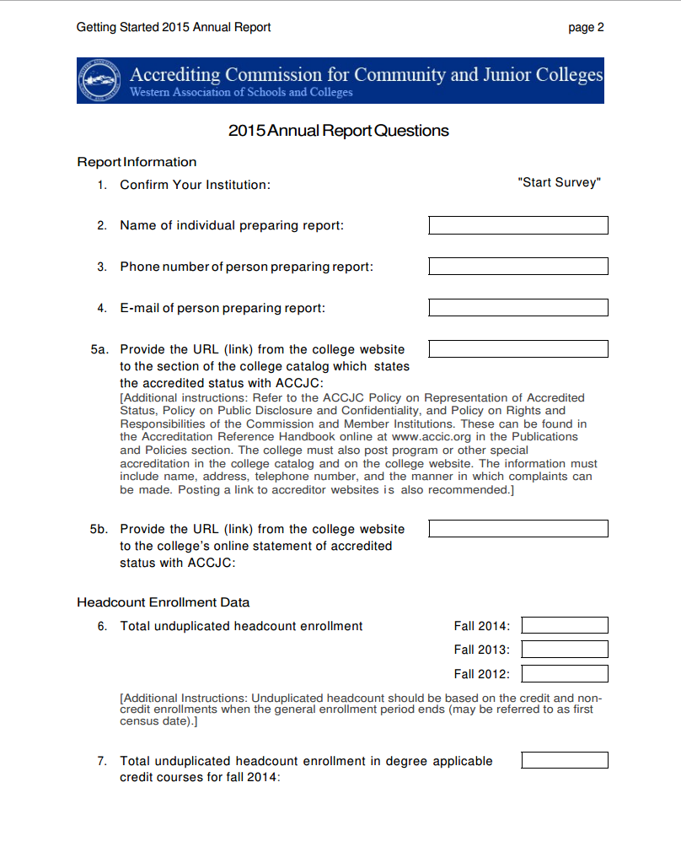
When Will We Report Any Changes?
Annual report released around March each year
Report out on our performance across a number of measures
Identify our ISS for each measure

Slide 5
Objectives for Today
Review historical data for remaining 2 college-wide student achievement indicators
  Graduates: Certificates
  Graduates: Associate Degrees or Certificates
Discuss and recommend an ISS for these 2 indicators
Confirm the recommendations for the other 4 indicators

Slide 6

Time to Get into the Data!

Slide 7
Course Success Rate
10-Year Average = 68%
Recommendation for
Institution-Set Standard: 71%

Slide 8
Retention/Persistence
Recommendation for
Institution-Set Standard: 53%
10-Year Average = 46%%

Slide 9
Graduates: Associate Degrees*
*Includes Associate Degrees for Transfer
Recommendation for
Institution-Set Standard: 1,200

Slide 10
Transfers*
Source: SDCCD Transfer Reports
*Updated 10/19/15
Recommendation for
Institution-Set Standard: 1,900

Slide 11
Graduates: Certificates*
*Includes Certificates of 12 units or more

Slide 12
Graduates: Degrees or Certificates*
*Includes Associate Degrees for Transfer, AS, AA, and certificates of 18 units or more

Slide 13
Next Steps
Confirm final two recommendations for standards
Share with participatory governance groups
Bring feedback back to the PIEC for review and discussion
Finalize standards during fall President’s Cabinet retreat
Submit new standards to ACCJC in spring 2016 annual report

Slide 14
Resources
Accreditation Institute 2013 Presentation on Institution-Set Standards
ACCJC Letter to External Evaluation Team Members
ACCJC Responses to Questions at ACCJC Accreditation Standards Symposum 2015

